Slide 1
MD-Staff Products

Slide 2
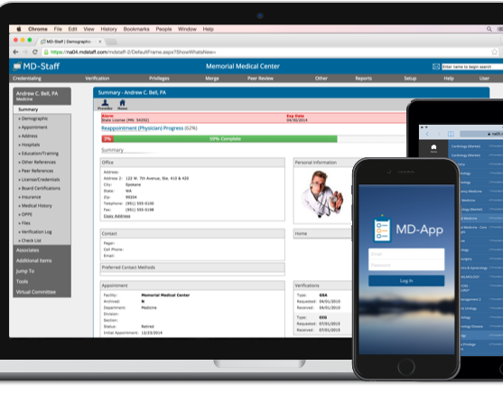

MD-Staff, ASM's flagship product, is a powerful credentialing solution designed to streamline and automate the credentialing and privileging processes, enhancing efficiency and compliance for healthcare organizations.
Features
Primary Source Verifications
Streamlines Workflows
Expansive Reporting
Real-Time Database
User-Friendly

Slide 3

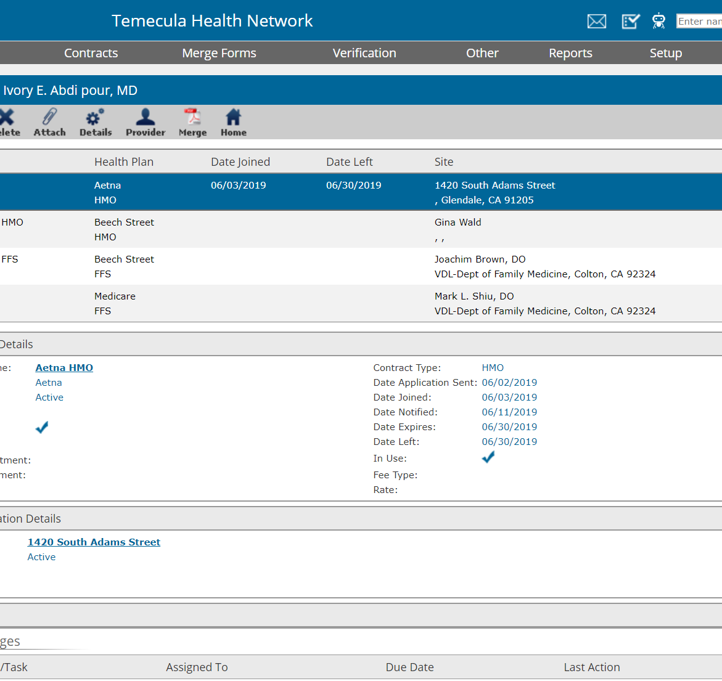
MD-Staff's Managed Care / Enrollment solution will boost payer outcomes with our automated provider solution, simultaneously cutting costs, expediting plan participation, and saving valuable time.
Features
Seamless Populate Insurance Applications
Enrollment Tracking
Plan Participation Management
Customizable Checklist

Slide 4

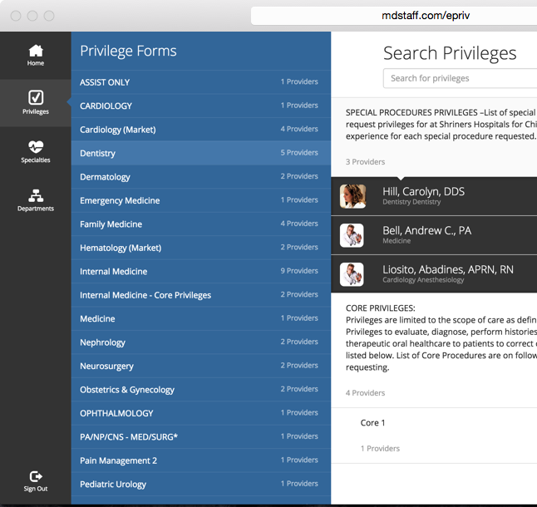
E-Priv is your gateway to real-time, online provider privilege distribution. Engineered to streamline the lengthy process of sharing and publishing clinical privileging reports, removing the need for printing.
Features
Read-Only Access
Customizable End-User Security
Robust Search Options
Curated Displays

Slide 5

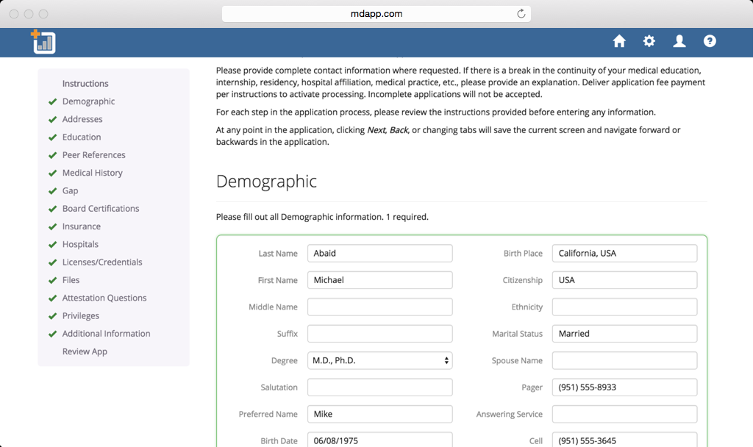
MD-App is designed to eliminate this manual process by allowing the providers to fill out the application online.
Features
Seamlessly Integrates MD-Staff
Dynamic Tracking Dashboard
Single-Source Database
Payment Processing

Slide 6

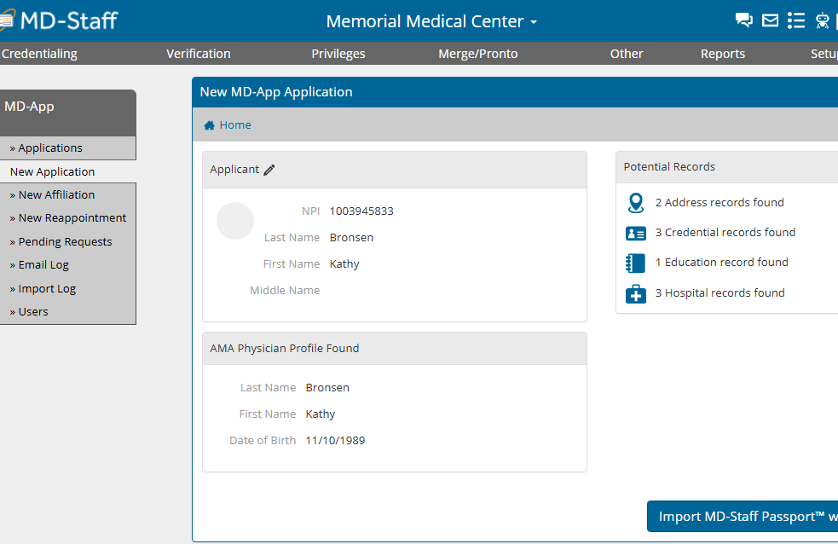
MD-Staff Passport™ pre-populates the provider's application automatically with verified information from secure sources.
Features
Provider’s Digital Profile
Reduce Onboarding Timeframe
Securely Stored Data
Data Sources include DEA, CDS, State Licenses, NPPES, MD-Query, CMS, AMA, ABMS, and Checksome™

Slide 7
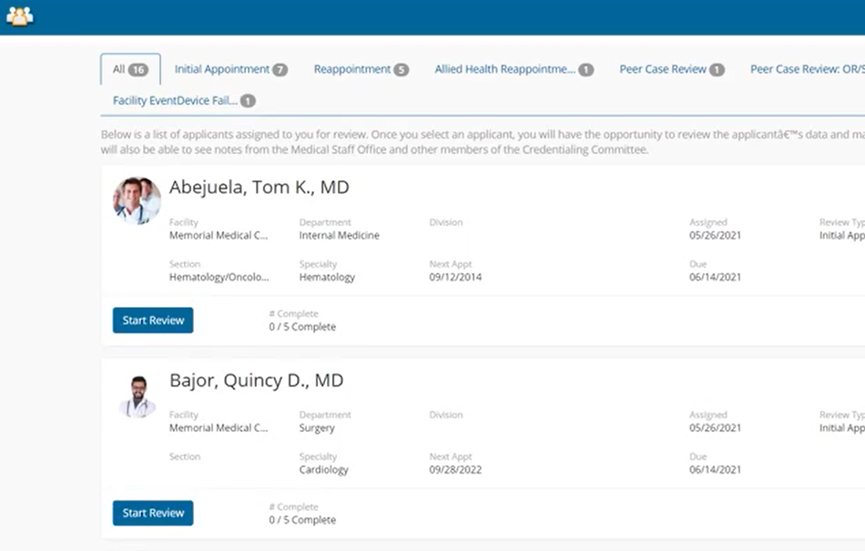
Virtual Committee is meticulously created with collaboration at its core. Streamline reviews of credentialing files, peer reviews, and case reviews simply and digitally.
Features
Interactive Workflows & Worksheets
Intuitive Dashboard
Flexible Configuration
Eliminate Paper Processing

Slide 8
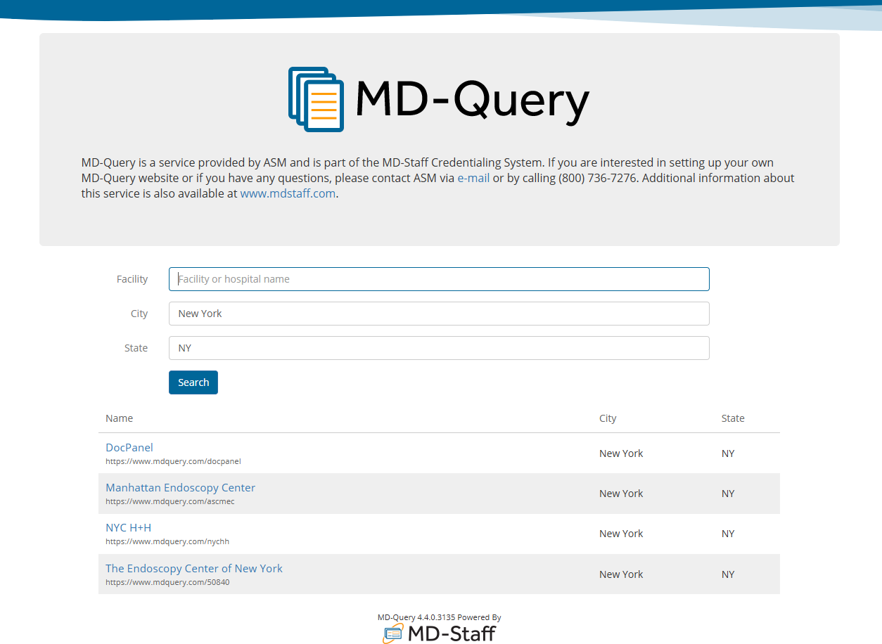

MD-Query is a secure, web-based application maintained by ASM that allows Medical Staff Professionals to quickly and economically create their own online verification system.
Features
Seamlessly Sync MD-Staff Records
Automatic Verification Letters
Dedicated Website
Enhanced Data Protection

Slide 9

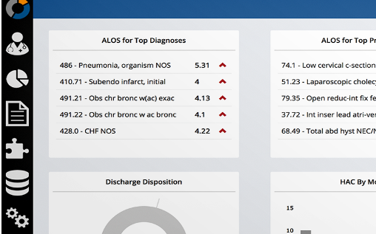
A stand-alone web application delivering provider performance data and analysis for hospitals and healthcare systems.
Features
Customizable Solutions
Data-Driven Design
Cross-Platform Optimization
Web-Based Efficiency

Slide 10




How to Reach Us
Applied Statistics & Management Inc.
ADDRESS
32848 Wolf Store Rd, Temecula CA 92592
EMAIL ADDRESS
info@mdstaff.com
PHONE NUMBER
(800) 736-7276

